Slide 1
Customer Churn Prediction Model – SyriaTel

Slide 2
Business Overview
Objective: To build a model that predicts whether a customer is likely to churn (stop using SyriaTel services).
Why it matters:
Acquiring new customers is 5x more expensive than retaining existing ones.
Early detection of churn risk helps increase customer loyalty and revenue.
Aligns with SyriaTel’s goal of enhancing customer satisfaction and retention.

Slide 3
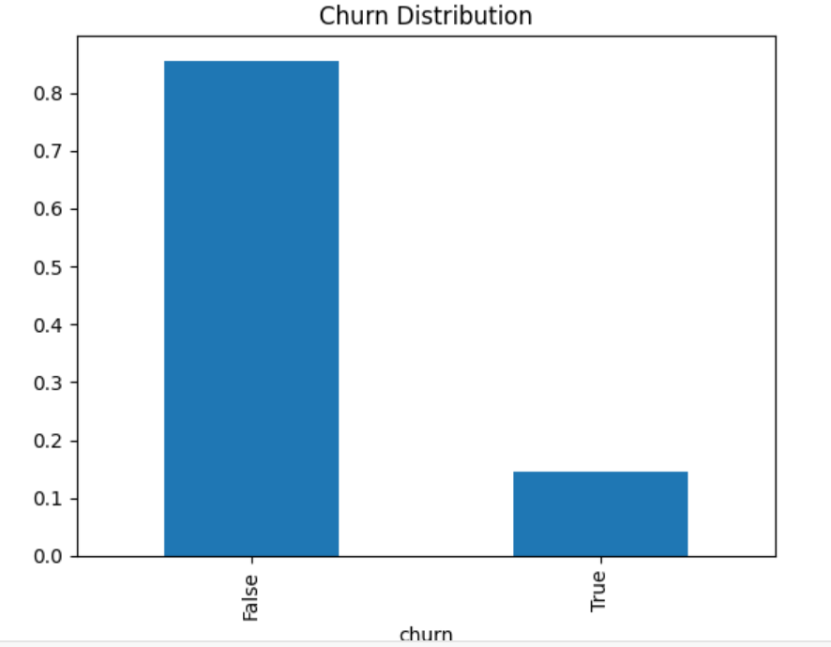
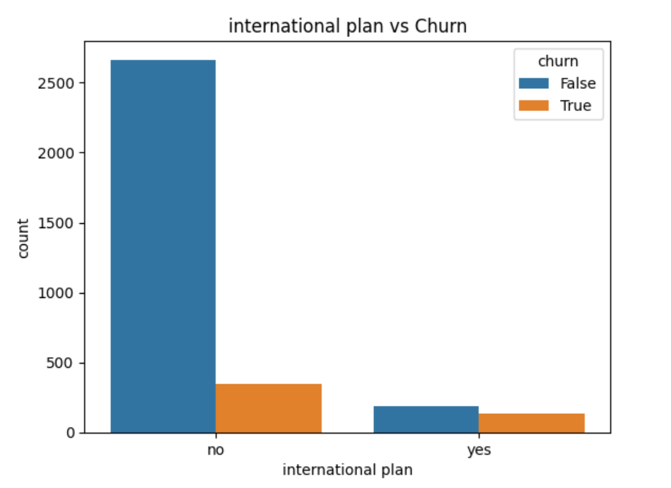
Exploratory Data Analysis (EDA)
What I Explored:
Demographics: Customer location and phone usage
Behavioral data: Call duration, number of calls, service plans
Churn rate: ~10% of customers churned
Key Observations:
High churn linked to multiple customer service calls
Customers without voice mail or international plans are more likely to churn
Usage patterns (day vs night) provide predictive signals

Slide 4
Data Processing and Modeling
How I Built the Model:
Data Cleaning
Removed irrelevant fields (e.g., phone number)
Converted text to numbers (e.g., Yes/No to 1/0)
Data Balancing
Only 10% churned → I used the SMOTE technique to balance data. This is an important step because if not undertaken, classification models tend to:
Favor the majority class (non-churners).
Show high accuracy, but miss the minority class (actual churners).
Make poor predictions for the very thing you're trying to detect
Model Training
I Tried various algorithms; then chose one with highest accuracy and reliability Random Forest Classifier was likely chosen due to High ROC-AUC score (~0.917).
The Gradient Boosting Machine had a slightly lower accuracy of ROC-AUC of 0.912 compared to this. After the tuning of the model, there was just a slight improvement in terms of change.
Outcome: Built a model that learns from customer behavior to predict churn before it happens.

Slide 5
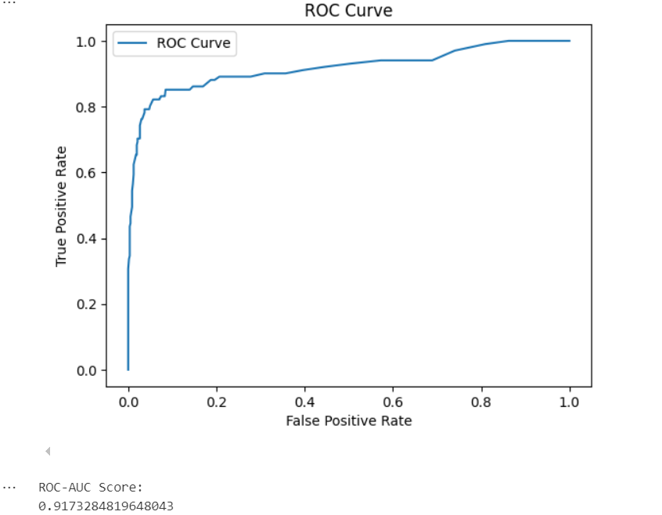
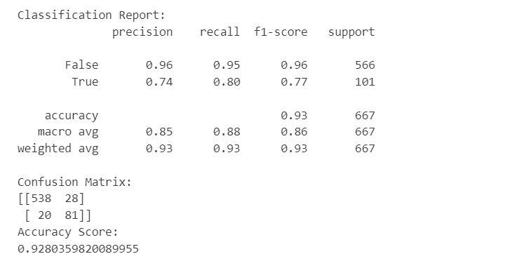
Model Performance & Results
Metric Used: ROC-AUC Score = 0.917 (Excellent Performance)
Interpretation:
91.7% accuracy in distinguishing between churners and non-churners.
The model is reliable and can be used for real-time customer scoring.

Slide 6
Key Insights
High Churn Risk Detected
The model shows high accuracy (AUC = 0.917) in the churn prediction.
This means that certain customer behaviors strongly correlate with churn, such as:
(a) High number of customer service calls.
(b) Not subscribing to voice mail or international plans.
(c) High charges during daytime usage.

Slide 7
Recommendations for the Business
Proactive Retention:
Call or offer discounts to predicted high-risk customers
Enhance Customer Support:
Improve issue resolution speed and quality
Bundle Plans & Offers:
Encourage uptake of voicemail and international packages
Data-Driven Strategy:
Use the model monthly to flag customers needing attention

Slide 8
Conclusion & Next Steps
Conclusion: The model provides early warning signals to prevent churn and save costs.
Next Steps:
Deploy the model into SyriaTel’s CRM system.
Continuously monitor and update with fresh data.
Expand this approach to other areas (upselling, segmentation).

Slide 9
Presented by: Kelvin Shilisia Date: 22nd July 2025
LinkedIn: www.linkedin.com/in/kelvin-shilisia-2b289b108
Email: kelvinshilisia@gmail.com

